Slide 1
Idea, searching and inserting in B+-tree

Slide 2
Overview over this video
The video will cover the basics of B+-trees as well as
Searching for values
Inserting pairs of values and pointers

Slide 3
Single Level vs Multi-Level Indexes
Value | Pointers
11 | …
21 | …
31 | …
… | …
Single level index: stored in single list
Multi-level index: distributed across different layers
Value | Pointers
101 | …
201 | …
301 | …
… | …
Value | Pointers
1 | …
2 | …
3 | …
… | …
Value | Pointers
1001 | …
2001 | …
3001 | …
… | …
Value | Pointers
111 | …
121 | …
131 | …
… | …
Value | Pointers
1101 | …
1201 | …
1301 | …
… | …
Level 1
…
Single-level index
Level 3
…
Level 2

Slide 4
B+ Tree: Leaves (Idea)
sorted in
increasing order
a₁
a₂
…
a_{n}
next leaf
Points to tuples with value a₁
Points to tuples with value a₂
Points to tuples with value a_{n}
n = chosen such that node fits into a single disk block
Example:
Disk block size = 512 byte
Values: 4 byte integers
Pointers: 8 bytes
n = 42
(512 ≥ 42 (8+4)+8
512 < 43 (8+4)+8)

Slide 5
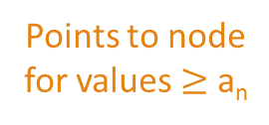
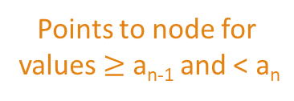
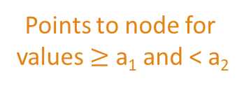
B+ Tree: Inner Nodes (Idea)
sorted in
increasing order
a₁
a₂
…
a_{n}
Points to node for values < a₁
Points to node for values $≥$ a₁ and < a₂
Points to node for values $≥$ a_{n-1} and < a_{n}
Points to node for values $≥$ a_{n}
Pointers point to B+ tree nodes at level below
n = chosen as before

Slide 6
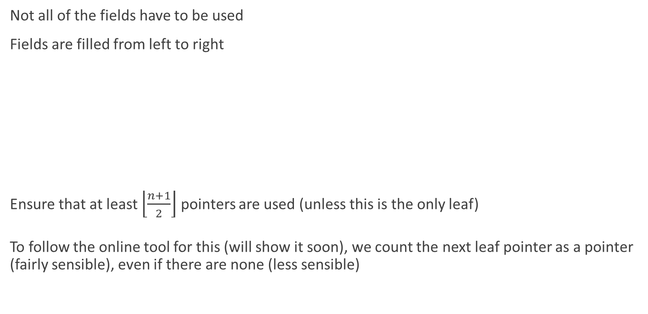
B+ Tree: Leaves (Actually)
Not all of the fields have to be used
Fields are filled from left to right
Ensure that at least $\left\lfloor \frac{n+1}{2}\right\rfloor$ pointers are used (unless this is the only leaf)
To follow the online tool for this (will show it soon), we count the next leaf pointer as a pointer (fairly sensible), even if there are none (less sensible)
unused
a₁
a₂
a_{i}
next leaf
Points to tuples with value a₁
Points to tuples with value a₂
Points to tuples with value a_{i}
don’t point anywhere

Slide 7
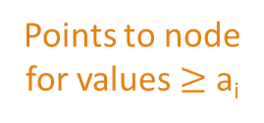
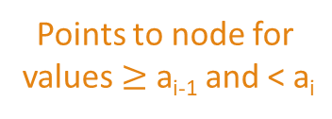
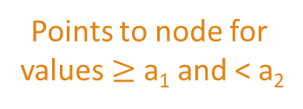

B+ Tree: Inner Nodes (Actually)
Number is smallest number in child-subtree slightly to the right
unused
Similar as for leaves:
Ensure that at least $\left\lceil \frac{n+1}{2}\right\rceil$pointers are used
Exception: root must use $≥$ 2 pointers
a₁
a₂
a_{i}
point nowhere
Points to node for values < a₁
Points to node for values $≥$ a₁ and < a₂
Points to node for values $≥$ a_{i-1} and < a_{i}
Points to node for values $≥$ a_{i}

Slide 8
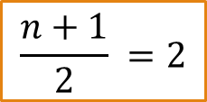
A B+ Tree Index
Height 3
13
n = 3
$$\frac{n+1}{2} =2$$
7
23
31
43
2
3
5
7
11
13
17
19
23
29
31
37
41
43
47
(Example from ”Database Systems: The Complete Book”)

Slide 9
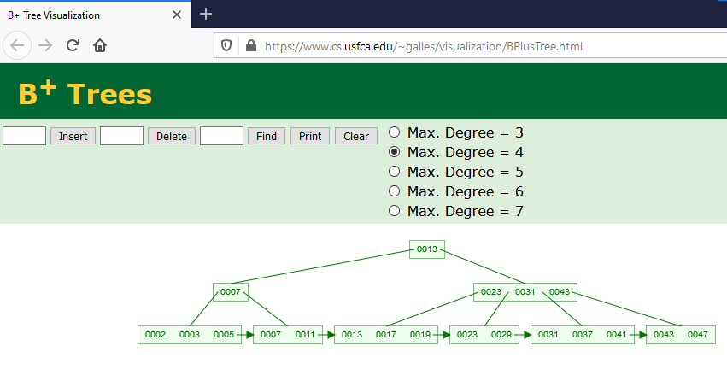
Online version

Slide 10


Looking Up Values
Example: get pointer to tuples with value 29
13
13 $≤$ 29
7
23
31
43
23 $≤$ 29 < 31
2
3
5
7
11
13
17
19
23
29
31
37
41
43
47
(Example from ”Database Systems: The Complete Book”)

Slide 11
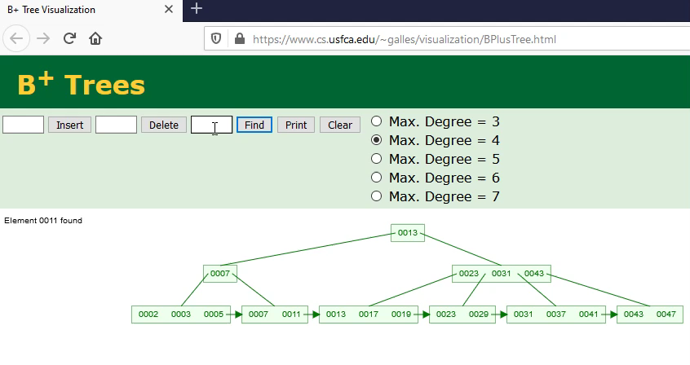
Online version of looking for 29

Slide 12

Example 2
Example: get pointer to tuples with value 11
13
11 < 13
7
23
31
43
7 $≤$ 11
2
3
5
7
11
13
17
19
23
29
31
37
41
43
47
(Example from ”Database Systems: The Complete Book”)

Slide 13

Online version of looking for 11

Slide 14
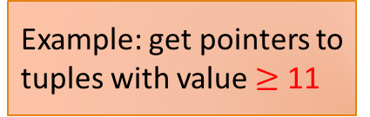
Example 3
Example: get pointers to tuples with value $≥$ 11
13
11 < 13
7
23
31
43
7 $≤$ 11
2
3
5
7
11
13
17
19
23
29
31
37
41
43
47
(Example from ”Database Systems: The Complete Book”)

Slide 15

Example 4
Exercise: get pointer to tuples with value 9
13
9 < 13
7
23
31
43
7 $≤$ 9
2
3
5
7
11
13
17
19
23
29
31
37
41
43
47
9 doesn’t exist → no tuples with value 9!
(Example from ”Database Systems: The Complete Book”)

Slide 16

Online version of looking for 9

Slide 17

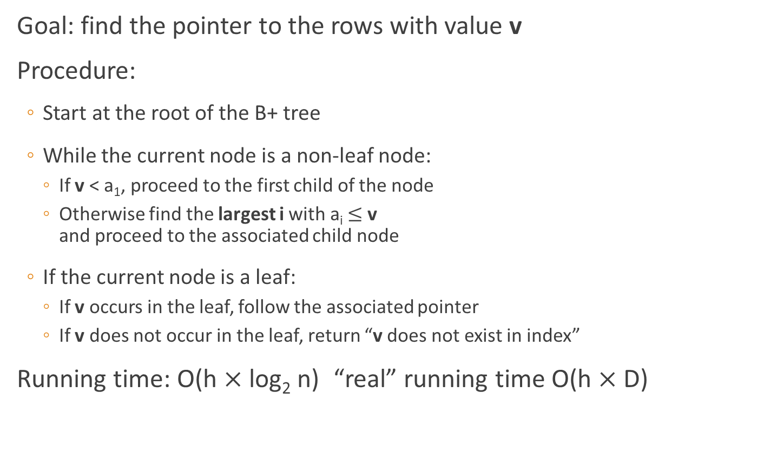
Looking Up A Value: Summary
Goal: find the pointer to the rows with value v
Procedure:
Start at the root of the B+ tree
While the current node is a non-leaf node:
If v < a₁, proceed to the first child of the node
Otherwise find the largest i with a_{i} $≤$ v and proceed to the associated child node
If the current node is a leaf:
If v occurs in the leaf, follow the associated pointer
If v does not occur in the leaf, return “v does not exist in index”
Running time: O(h $×$ log₂ n) “real” running time O(h $×$ D)
a₁
…
a_{i}
…
if v < a₁
if a₁ $≤$ v
Time for a disk operation
Height of the B+ tree

Slide 18


Insertions of Value/Pointer Pairs
Task: insert value 48
13
13 $≤$ 48
7
23
31
43
43 $≤$ 48
2
3
5
7
11
13
17
19
23
29
31
37
41
43
47
48
(Example from ”Database Systems: The Complete Book”)

Slide 19
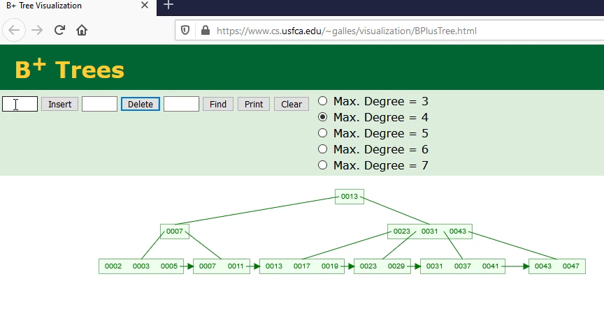
Online version of inserting 48

Slide 20


Insertions of Value/Pointer Pairs
Task: insert value 42
13
13 $≤$ 42
7
23
31
43
31 $≤$ 42 < 43
2
3
5
7
11
13
17
19
23
29
31
37
41
43
47
48
(Example from ”Database Systems: The Complete Book”)
Need to make space for 42

Slide 21
Insertions of Value/Pointer Pairs
Task: insert value 42
13
13 $≤$ 42
7
23
31
43
31 $≤$ 42 < 43
2
3
5
7
11
13
17
19
23
29
31
37
41
43
47
48
(Example from ”Database Systems: The Complete Book”)
Split the node

Slide 22
Insertions of Value/Pointer Pairs
Task: insert value 42
13
7
23
31
43
2
3
5
7
11
13
17
19
23
29
43
47
48
31
37
41
Split the node
(Example from ”Database Systems: The Complete Book”)

Slide 23
Insertions of Value/Pointer Pairs
Task: insert value 42
13
7
23
31
43
2
3
5
7
11
13
17
19
23
29
43
47
48
31
37
41
(Example from ”Database Systems: The Complete Book”)

Slide 24
Insertions of Value/Pointer Pairs
Task: insert value 42
13
7
23
31
43
2
3
5
7
11
13
17
19
23
29
43
47
48
31
37
41
(Example from ”Database Systems: The Complete Book”)

Slide 25
Insertions of Value/Pointer Pairs
Task: insert value 42
13
Problem: not yet a B+ tree
7
23
31
43
2
3
5
7
11
13
17
19
23
29
43
47
48
Insert value
31
37
41
42
(Example from ”Database Systems: The Complete Book”)

Slide 26
Insertions of Value/Pointer Pairs
Cannot add the new leaf as a child
Task: insert value 42
13
Solution: split
7
23
31
43
2
3
5
7
11
13
17
19
23
29
43
47
48
31
37
41
42
(Example from ”Database Systems: The Complete Book”)

Slide 27
Insertions of Value/Pointer Pairs
Task: insert value 42
13
7
23
31
43
2
3
5
7
11
13
17
19
23
29
43
47
48
31
37
41
42
(Example from ”Database Systems: The Complete Book”)

Slide 28
Insertions of Value/Pointer Pairs
Task: insert value 42
13
7
23
31
43
2
3
5
7
11
13
17
19
23
29
43
47
48
31
37
41
42
(Example from ”Database Systems: The Complete Book”)

Slide 29
Insertions of Value/Pointer Pairs
Insert value
Add the new node as a child
Task: insert value 42
13
41
7
23
31
43
2
3
5
7
11
13
17
19
23
29
43
47
48
31
37
41
42
(Example from ”Database Systems: The Complete Book”)

Slide 30
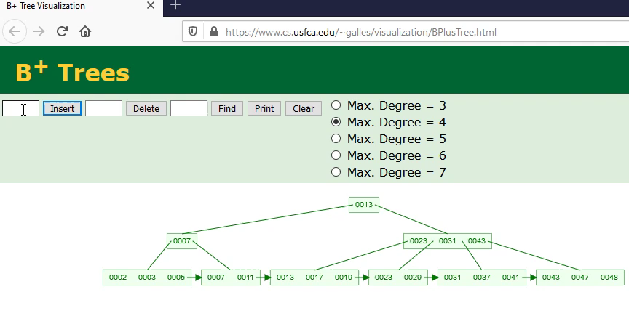
Online version of inserting 42

Slide 31
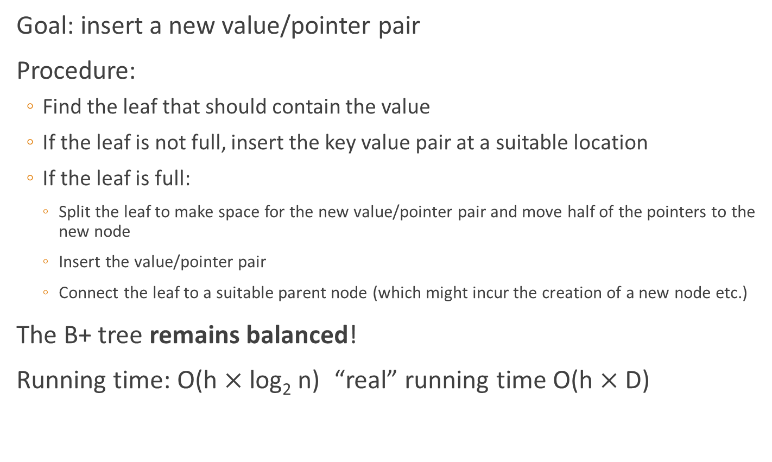
Insertion: Summary
Goal: insert a new value/pointer pair
Procedure:
Find the leaf that should contain the value
If the leaf is not full, insert the key value pair at a suitable location
If the leaf is full:
Split the leaf to make space for the new value/pointer pair and move half of the pointers to the new node
Insert the value/pointer pair
Connect the leaf to a suitable parent node (which might incur the creation of a new node etc.)
The B+ tree remains balanced!
Running time: O(h $×$ log₂ n) “real” running time O(h $×$ D)
Time for a disk operation
Height of the B+ tree

Slide 32
Summary
The video provided an overview over the idea of B+-trees and how to search and insert into them
Slide 16 has a summary of lookups
Slide 27 has a summary of insertions

